Slide 1
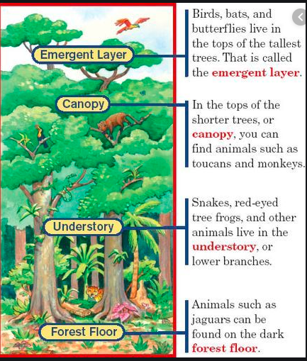
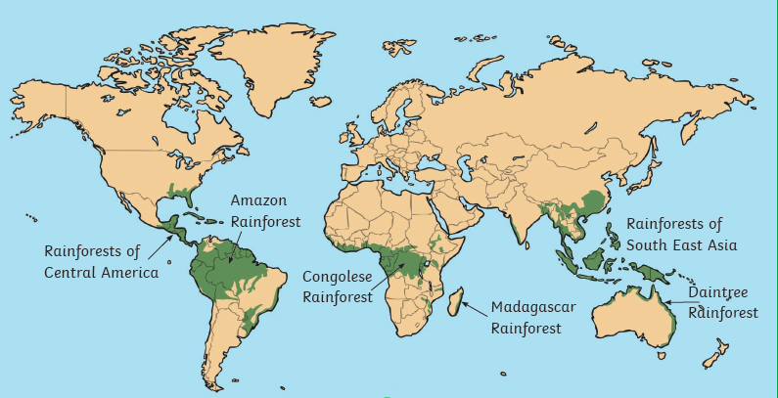
Rainforests – Year 3 Autumn Term – Topic 2
Layers of the rainforest
Locations
Rainforests | A tall, dense jungle that has a high amount of rainfall per year. The climate of a rain forest is very hot and humid so the animals and plants that exist there must learn to adapt to this climate.
Climate | Weather conditions in an area over a long period of time. E.g. Tropical climate
Equator | An invisible line around the middle of the Earth It divides the earth into the Northern Hemisphere and the Southern Hemisphere.
Deforestation | The destruction of trees or forests on a massive scale
Conservation | The protection of plants, animals and natural areas.
Threat | Something that is a danger to the rainforest
South
America
Brazil
Fantastic facts
*Tropical rainforests are hot and wet all year round.
*5% of the Earth’s surface is the Amazon rainforest basin.
*The Amazon rainforest covers 9 countries in South America. 60% of it is in Brazil.
*The Amazon is home to around 25% of all land and freshwater species and 40,000 plant species.
Temperature | degree of hotness or coldness as measured on a scale
Products | Things that are made from the rainforest
Protection | Keeping something safe.

