Slide 1
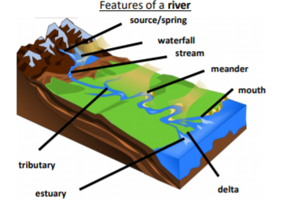
Yr 5 Topic - Our World: Rivers
Rivers of the World
Yangtze River | Asia | 6300 km
Amazon | South America | 6400 km
The Nile | Africa | 6650 km
Missouri River | North America | 3767 km
Murray River | Oceania/ Australia | 2508 km
Volga | Europe | 3530 km
Features of a River
Vocabulary
1 | source | The starting point of the river.
2 | mouth | The place where a river enters the sea
3 | meander | To take a winding course to wander.
4 | tributary | A river or stream that flows into a larger one or into a lake.
5 | valley | A long low area between hills. An area through which a river flows.
6 | flood plain | An area of low-lying ground adjacent to a river, formed mainly of river sediments and subject to flooding.
7 | estuary | The mouth of the river where it reaches the sea and the tide flows in and out.
8 | erosion | The wearing away of the earth’s surface by the action of water or wind.
9 | deposition | The action of depositing something.
10 | dam | A wall built to hold water back.
Rivers of the UK
River Severn | Wales/ England | 354 km
River Thames | England | 346 km
River Trent | England | 297 km
River Soar | England | 95 km
River Wye | Wales/ England | 215 km
Erosion and Deposition

