Slide 1
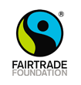
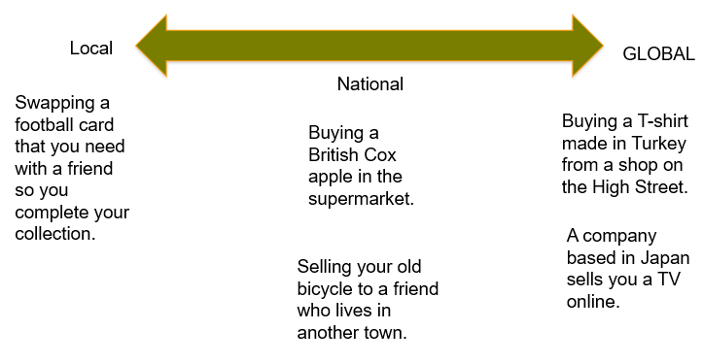
Y6 – Global Trade (Geography)
The Supply Chain of a Cotton Jumper
1 | Cotton is picked in Peru on the cotton plantations.
2 | The cotton is then sent to a cleaning station in Peru, which cleans and straightens the cotton.
3 | The cotton is sent to Turkey, where it is put on a spinning frame and turned into yarn for clothes. It is then sent to a local factory for dyeing.
4 | Zips are produced in India made from plastic and metal. They are then sent to the factory in Turkey to be used on clothes.
5 | The cotton and the zips are used to sew jumpers in Southern Turkey.
6 | A lorry transports the finished jumpers from Turkey to big stores in the United Kingdom.
7 | The clothing company office organizes the deliveries to customers and local shops.
8 | The cotton jumpers are then either delivered to people who order them online or sold in local shops.
Fairtrade Facts
1 | There are over 4,500 Fairtrade different products for sale in the UK.
2
3 | Almost 1 in 3 bananas sold in the UK is Fairtrade.
4 | Buying Fairtrade products can help to tackle climate change issues.
Vocabulary
1 | local | Restricted to a particular area or neighbourhood
2 | national | Relating to a whole country
3 | global | Relating to the whole world; worldwide
4 | trade | the buying and selling of goods and services we want and need
5 | Fairtrade | A worldwide movement that aims to help farmers in developing countries to get a fair price for their goods
6 | import | To bring goods or services into a country from abroad for sale
7 | export | To send goods or services to another country for sale
8 | product | Something that is made to be sold
9 | economic | Relating to trade, industry and the creation of wealth
10 | supply | To make something that is needed or wanted available to people
The Fairtrade logo can be found on coffee, tea, chocolate, fruit and even footballs.
The scale of trade

